Slide 1
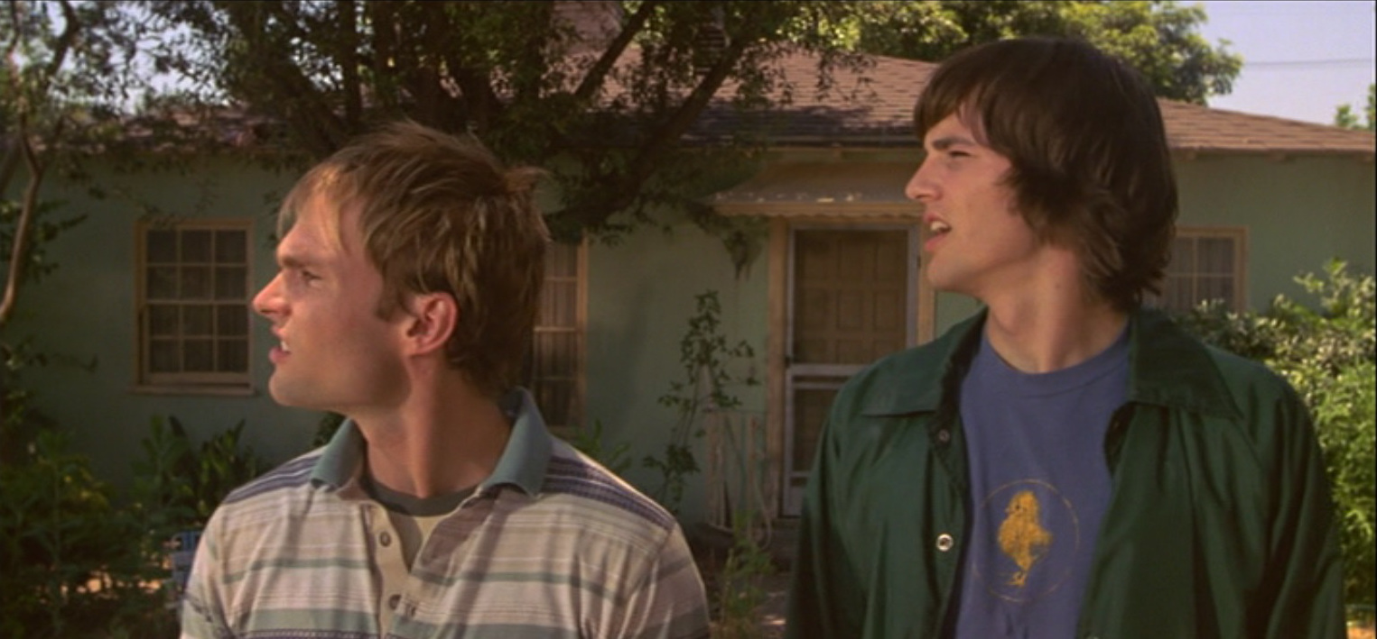
Dude, Where’s My House?
Estimating the monetary damage
caused by a natural disaster to a house.
Aman Hafez
Kavan Pandya
Yan Nusinovich

Slide 2
Introduction
If someone’s house is hit by a natural disaster, one of the first questions they will want answered after they evacuate the house is, “How much has my house been damaged and how can I get my insurance money back?” Our program is here to help:
The user uploads an image of their damaged house.
The program assesses the damage.
The program retrieves a picture of the undamaged house from Google Street View.
The user receives an estimate of the value of the house before the disaster, and the monetary damage to the house.

Slide 3
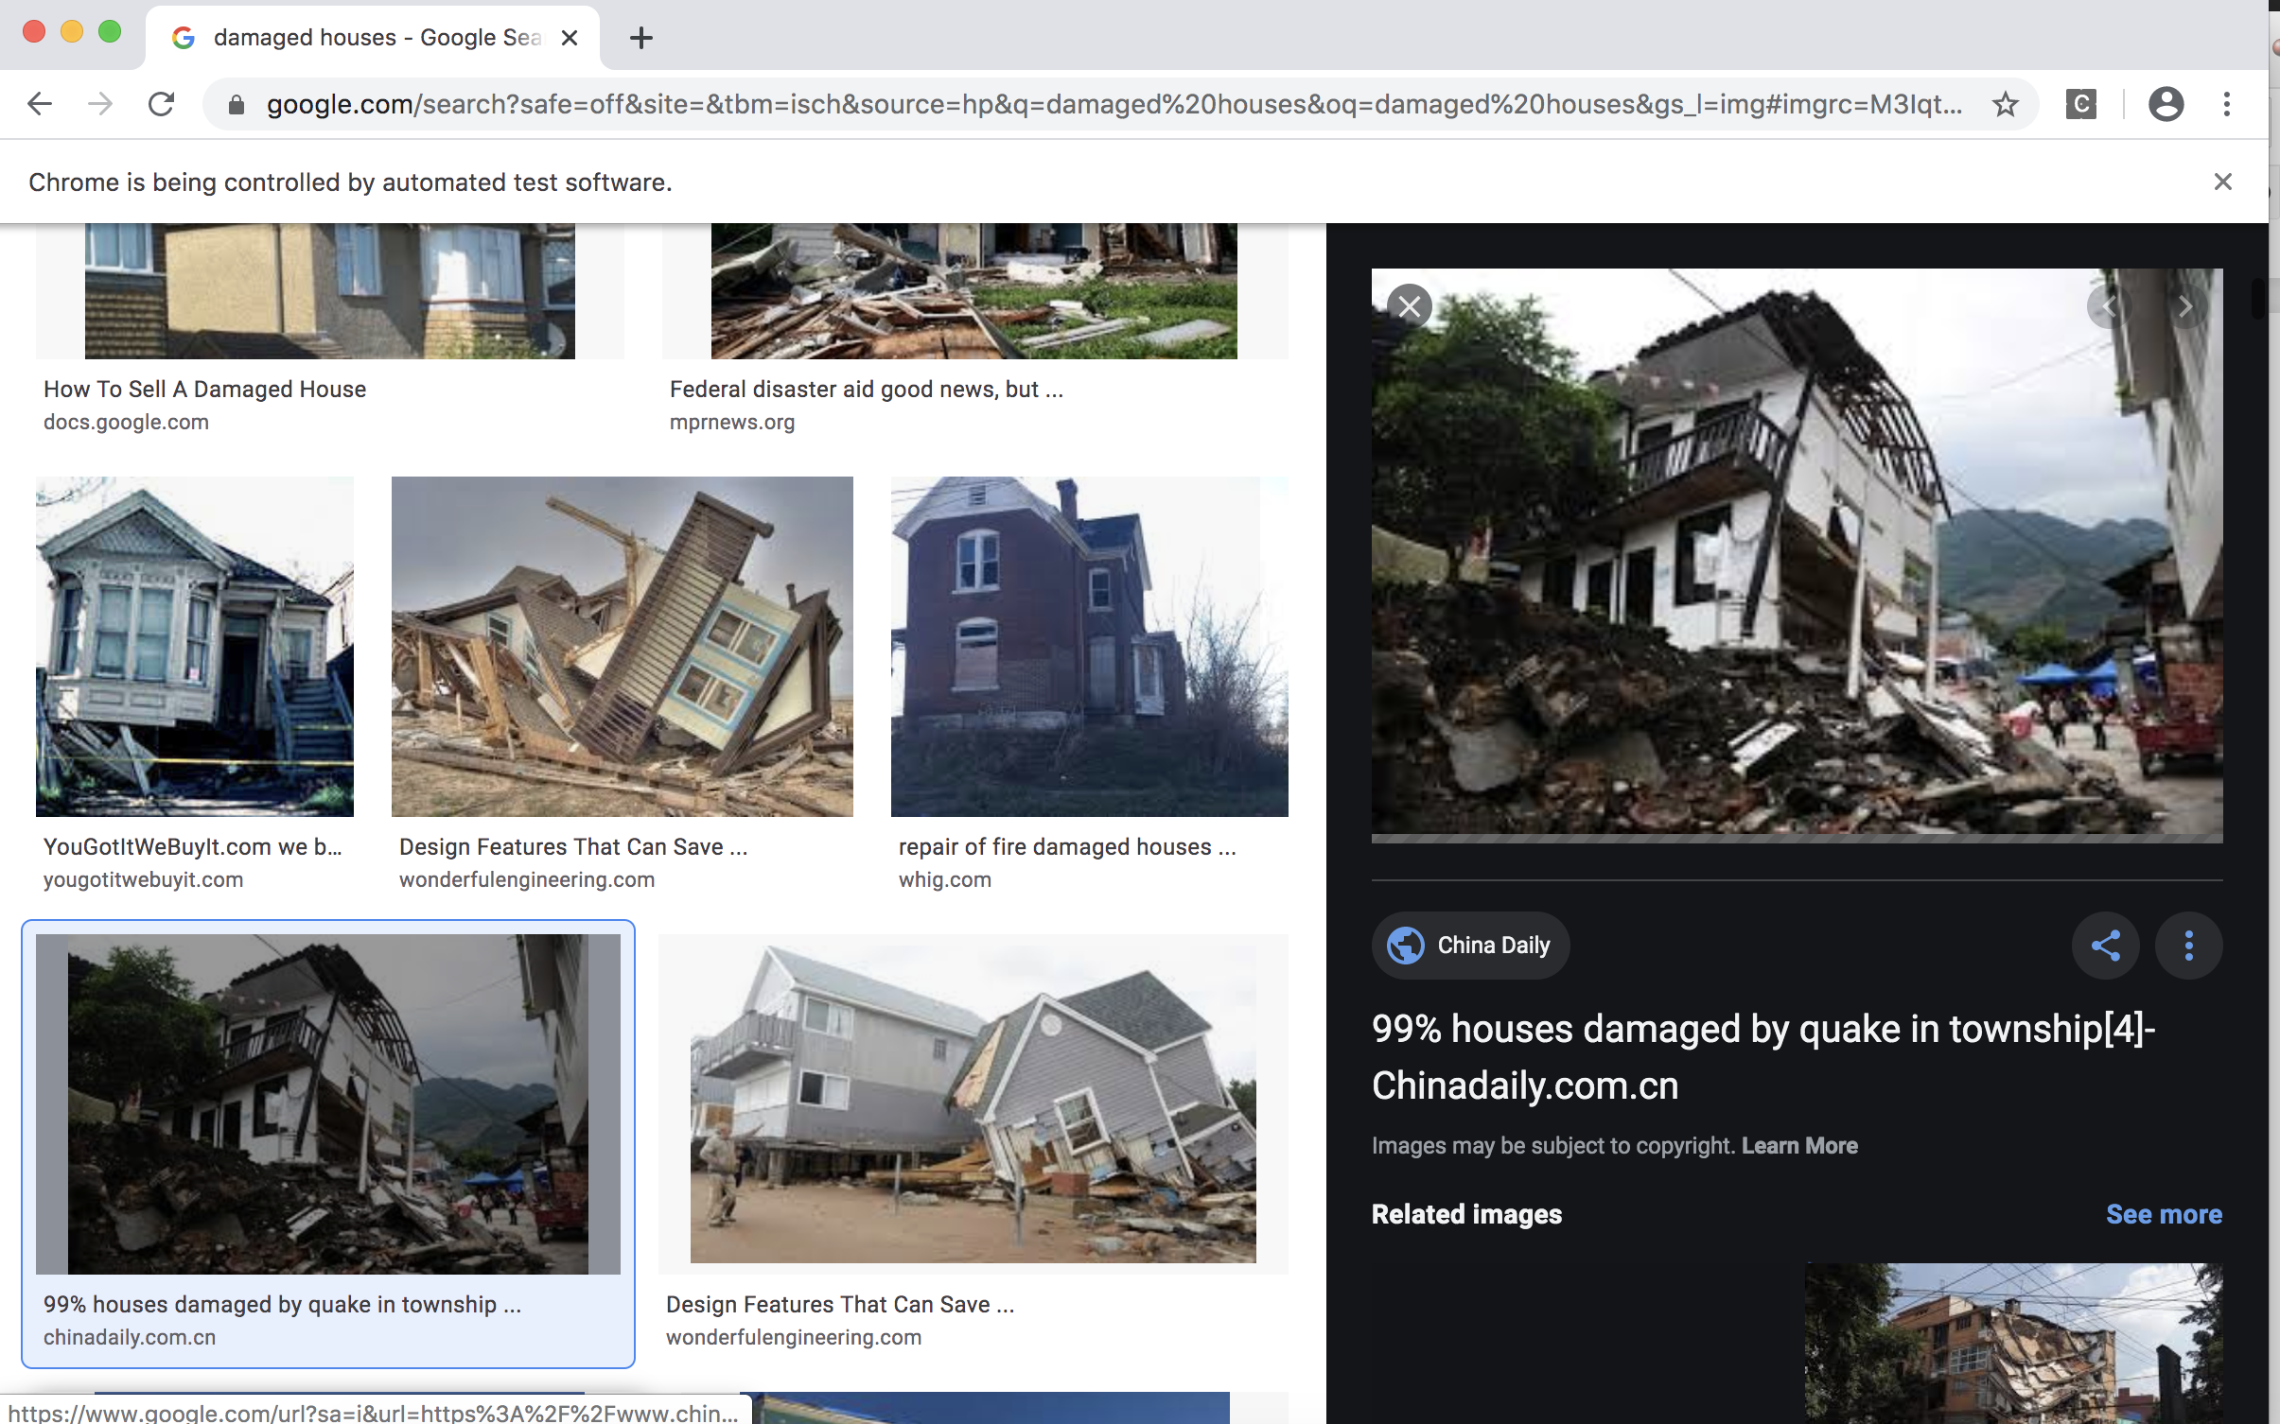
Data Gathering
We used the Google Chrome web driver.
We downloaded images using the Selenium package in Python to automate web browser interaction.
We scraped images from Google Image searches for these terms:
good houses
hurricane damaged houses, fire damaged houses, flood damaged houses, minor house damage, houses partially damaged by natural disasters
houses destroyed in natural disasters
The total number of images was 1,254.

Slide 4
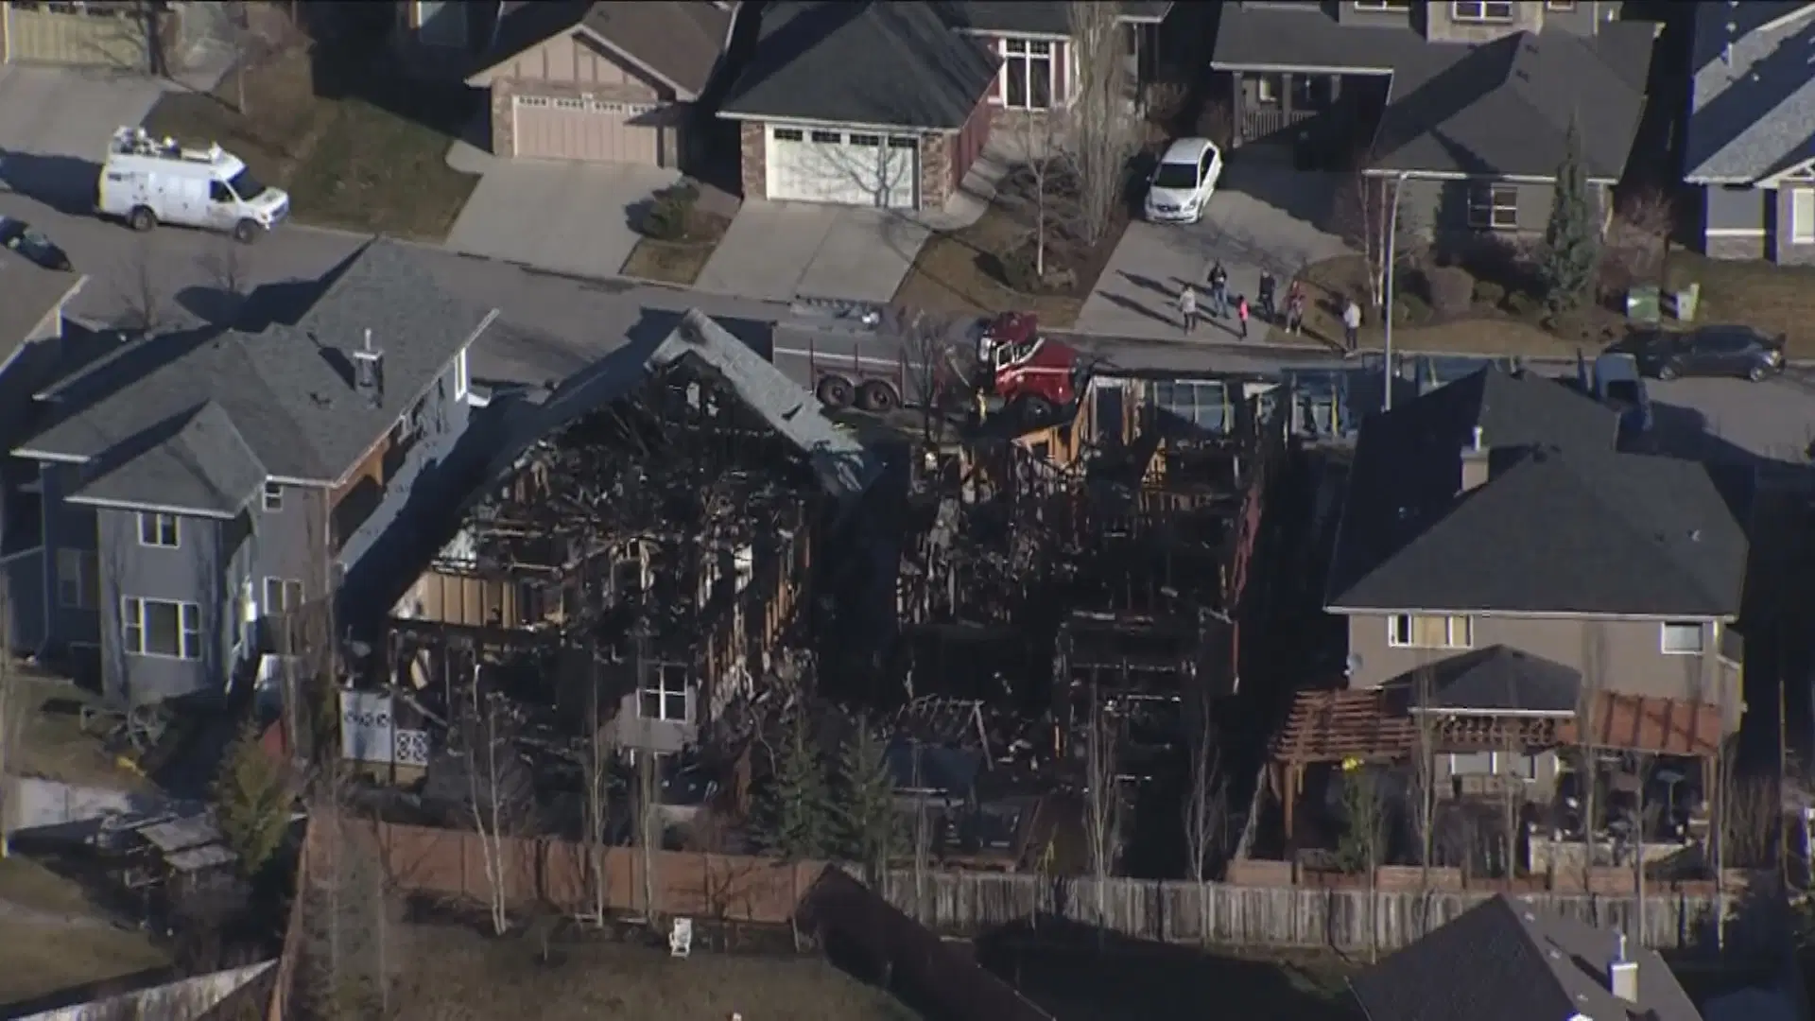
Data Cleaning
We ran code to delete duplicate images, and then we classified the remaining images by hand into the following categories:
Good houses
Damaged houses
Destroyed houses
Images to discard
The following types of images were discarded:
Satellite or helicopter views
Images of buildings other than houses
Repeat images that were resized or cropped differently
We were left with 1,095 images.

Slide 5
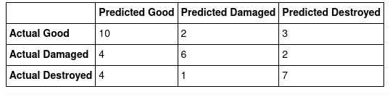
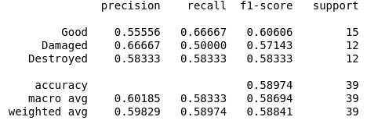
Modeling
Convolutional neural network
14 layers
All images resized to 256 x 256
Success criteria for choice of model
Validation accuracy
Performance
Validation accuracy of 70.96% compared to a baseline accuracy of 38.22%
Test accuracy of 58.97% compared to a baseline accuracy of 38.46%.

Slide 6


API Calls
Extract location information from image metadata.
Use location to fetch a street address and a Google Street View Image.
Use street address to fetch Zillow Estimate.
Combine with house condition predicted by model to estimate monetary damage .

Slide 7
Conclusions
Selenium is a versatile web driver tool that can be used to automate downloading all the images from a web page.
Neural networks are a great tool for breaking down images into their components and finding trends in images.
Many websites, like Google Street View and Zillow, provide APIs for developers to interface with their data.
Using our program, an individual affected by a natural disaster can quickly get backup information needed for their insurance claim, and armed with that information they can start getting back on their feet.

Slide 8
Next Steps
Standalone web app or phone app
Additional data
Additional classes to have a better estimate resolution
Additional APIs for house valuation
Training on other types of buildings, e.g., stores, schools, and places of worship
Adding images with more “noise”
Testing larger models that take more computational power to train

Slide 9
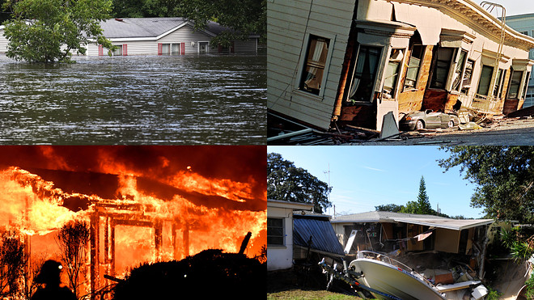
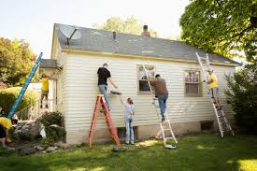
Questions?

